Slide 1
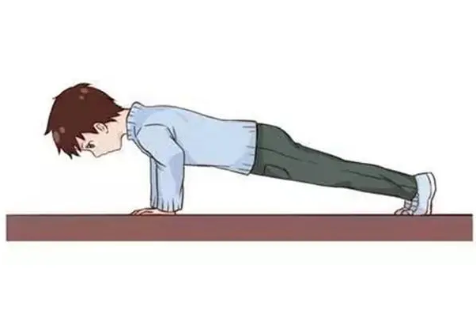
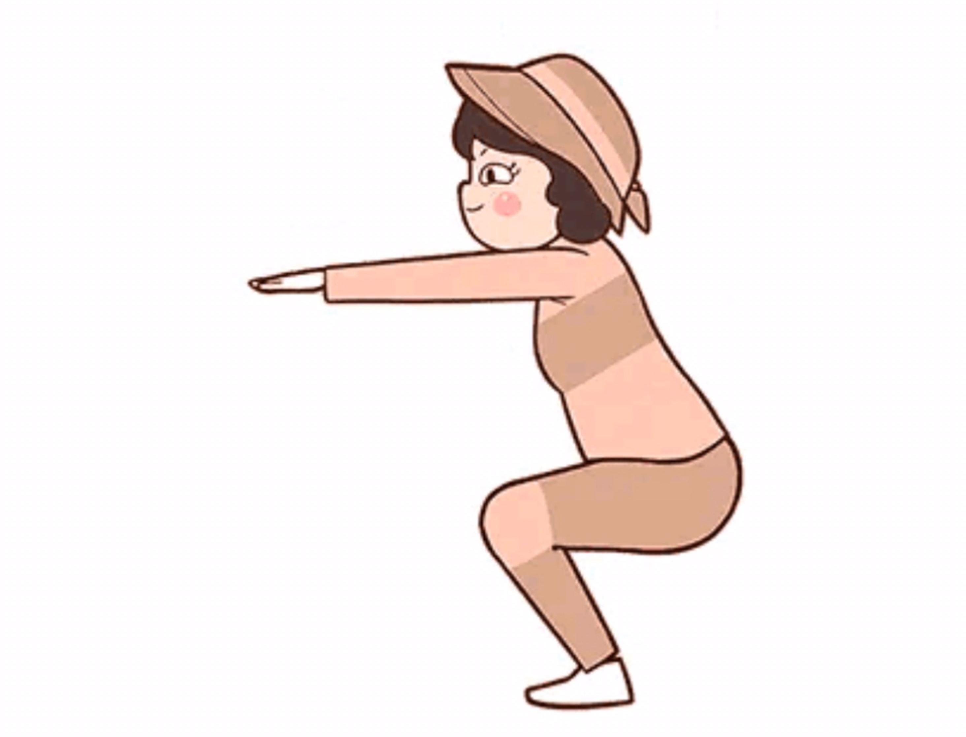
Real-time AI Fitness Monitoring System
Team：王绪龙 202230310264
王 昊 202230310262
裘罗荧 202230310247247
PPT汇

Slide 2
1
Project overview
2
Project schedule
3
Project design
4
Project process
CONTENTS
5
Risk
6
Test
7
Demo
8
Lessons learned

Slide 3
Project Overview

Slide 4

Overview
Project introduction: This project aims to use the Mediapipe framework to build a human body posture detection model to achieve counting of push-ups and squats, and import the trained model into a mobile application to achieve real-time counting by calling the camera. This program can help users better grasp their own exercise status and improve exercise effects.
Program features:
1. Detect and count the user's push-up and squat postures in real time.
2.The test results are displayed on the screen in real time, which is convenient for users to view.

Slide 5
Project Schedule

Slide 6
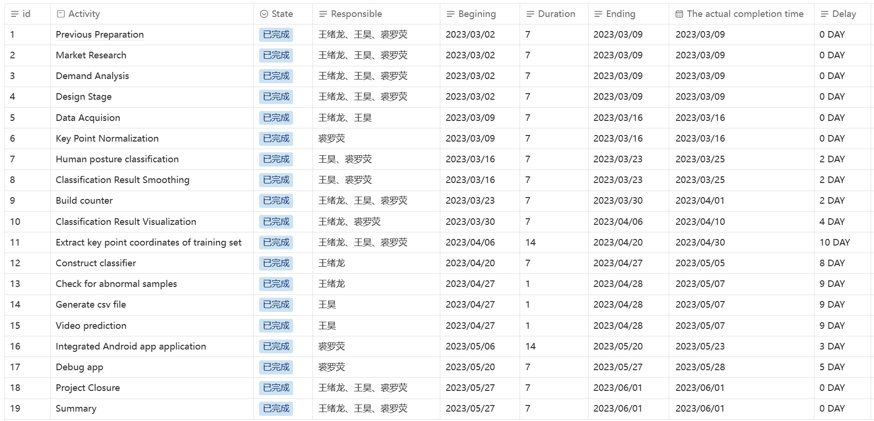
This is the project schedule, and the penultimate column is the actual completion time of the project activities. There are varying degrees of delays in the mid-project code writing and testing phases.

Slide 7
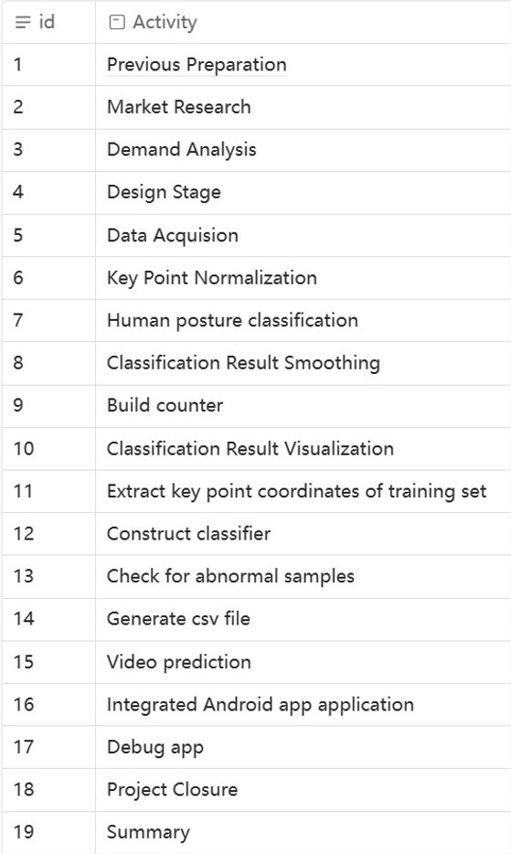
This is a graph of the planned time and actual completion time of each phase of the project. The green curve represents the project's planned time, and the orange curve represents the actual completion time of the project. Compared with the plan, there were different degrees of delays in each stage, but the project was finally completed before the stipulated time.

Slide 8
Project Design

Slide 9
Project Design
The project design plan is as follows:
Read video/picture from local or camera
Get training samples
Get normalized landmarks
Classification using the K-NN algorithm
import csv file in app
Build related instances
Integrate with ML Kit applications
action count
Build and run the application
export .apk file
User installation and use
The specific plan is as follows:
(1) Collect image samples for target exercises and perform pose prediction on them.
(2) Convert the obtained pose flags into data suitable for a K-NN classifier, and use these data to form a training set.
(3) Perform the classification itself, followed by repeated counting.
(4) Use machine learning kits to detect gestures in Android development.
(5) Build app-related instances.
(6) Add the CSV file to the app's assets folder.
(7) Run the application, export the .apk to the mobile terminal for installation and use.
Notes:
In order to reduce the difficulty of algorithm development, the system only requires single-person pose detection. If the pose detection effect is good, then theoretically the counting of the exercise can be completed.
The counting rule is very simple: by observing the push-up posture, as long as the Euclidean distance between the key points representing the head and the key points representing the elbow changes periodically, it can be regarded as doing a push-up, and the frequency and period can be conveniently calculated for counting.
Therefore, the remaining problem is how to choose a model that can perform good pose detection quickly.

Slide 10
Project Process
Notes:
I will introduce some important points in our entire project, as well as our current and future work

Slide 11
Milestone
Stage | Milestone | Description
Stage 1 (3-4weeks) | Preparation of the dataset | The push up dataset contains at least 50 images, including at least 25 training images for the down and up movements. The squat dataset should contain at least 50 images, with at least 25 training images for the squat down and up actions, respectively.
Stage 2 (5-8weeks) | Requirements for testing indicators | We need to ensure that the FPS of the trained model exceeds 10, so that the project does not get stuck during work (FPS=10 means processing ten images per second)
Stage 3 (9-11weeks) | Basic function test | We need to test the basic functions of the entire project, such as key point detection of a single human body and real-time scheduling of cameras
Stage 4 (12-13weeks) | Project functional testing | We need to test our model in different environments,（For example, on the playground, in the dormitory, in the indoor sports field）select at least five scenarios, and count accurately,We need to complete this work within a week
Stage 5 (14-15) | Project deployment | Deploy our project to the front-end app and ensure it can be used normally

Slide 12
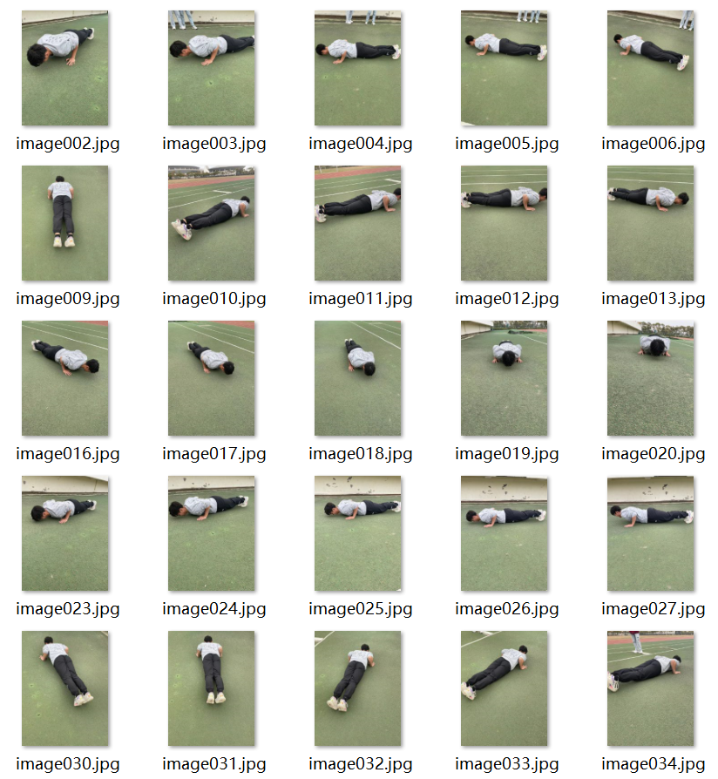
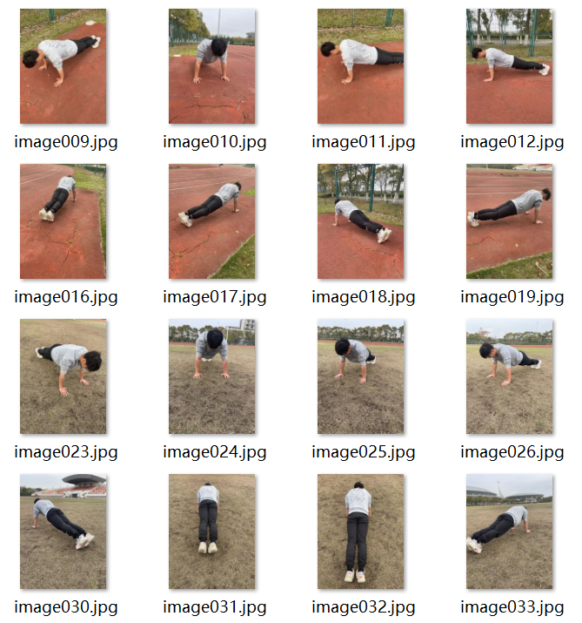
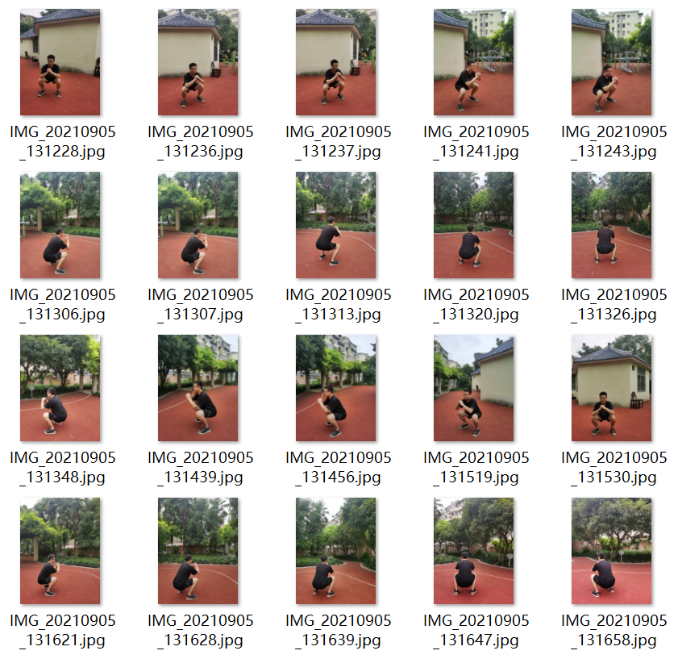
This is stage1, the stage of preparing and collecting the dataset. The dataset data we prepared is as follows：
 | Down | Up | Total
push up dataset | 42 | 34 | 76
squat dataset | 28 | 25 | 53

Slide 13
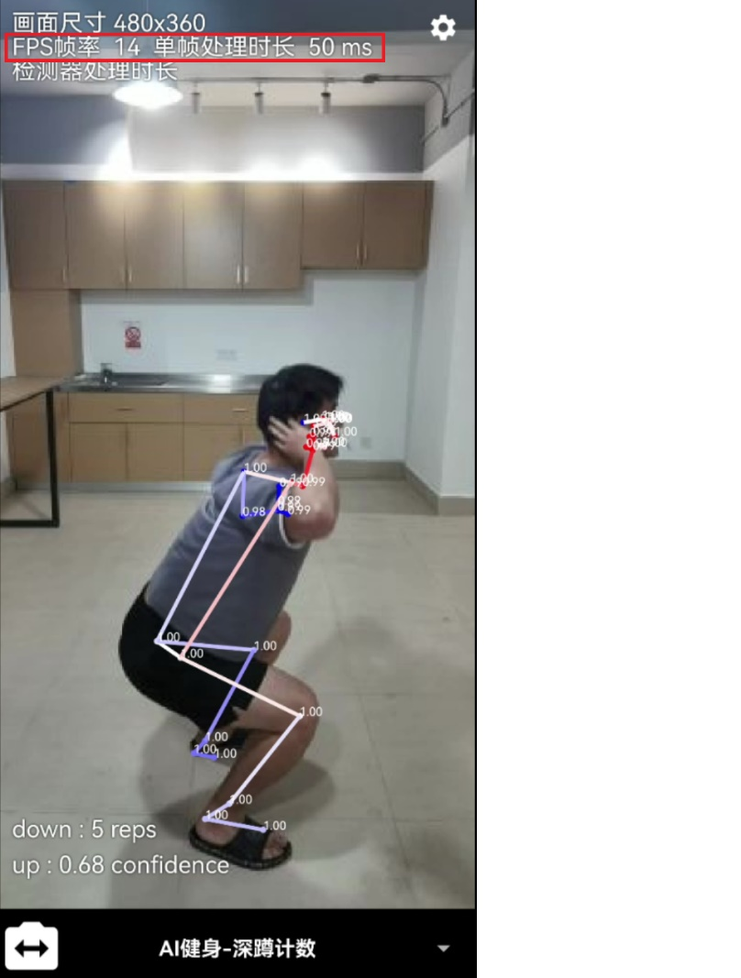
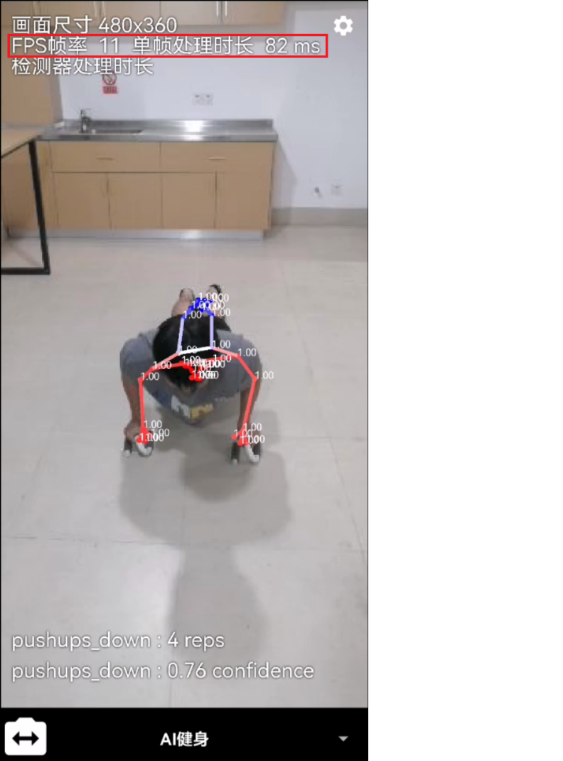
This is Stage 2. After the project code is written, it is necessary to ensure that the program can meet the basic needs of users. The program is not so slow to use and satisfies FPS>=10. The following is the running screenshot of the program.

Slide 14
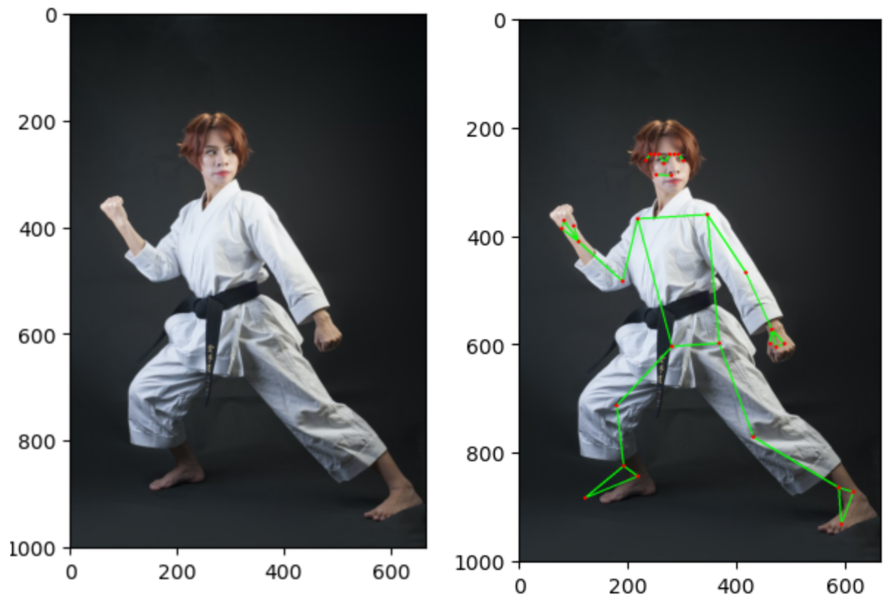
Stage3 ：After the basic code of the project is completed, the basic function code test of the program should be started to ensure that the program can run smoothly. Here are two test cases.
Test case | Image key point acquisition test
Testing purposes | Whether the test system can normally obtain the joint point information of the input image
Testing process | Import the toolkit, import the model, read in the image, input the model, obtain the prediction result, and obtain the pixel coordinates of key points
Desired result | Can get 33 key points of the input image and output the coordinates of the key points
Test Results | through, as shown

Slide 15
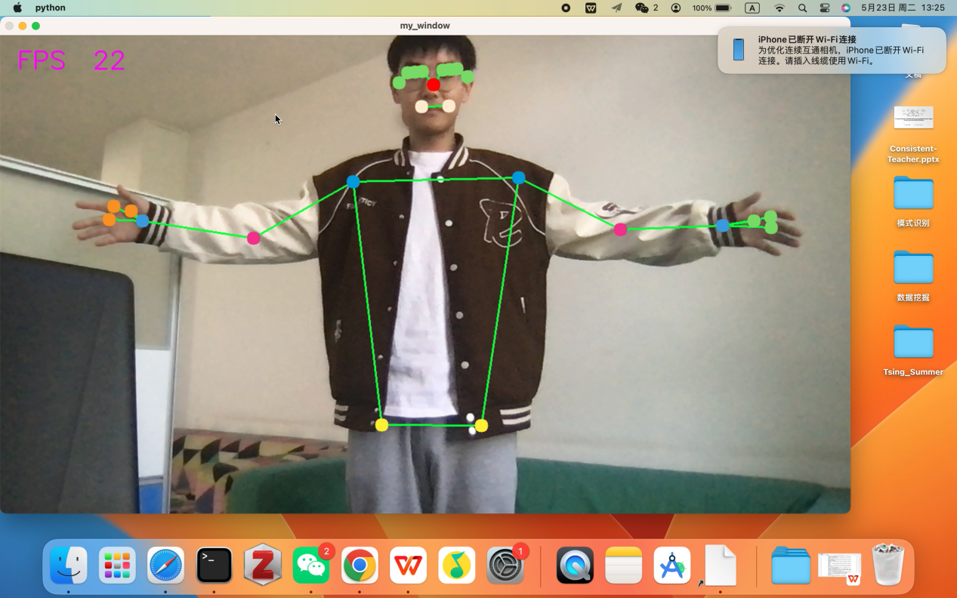
Test case | Image key point acquisition test
Testing purposes | Test whether the system can normally obtain device camera input and detect key points
Testing process | Import toolkit, import model, input model, process single frame data, call camera to get each frame data
Desired result | Successfully invoked the device camera, which can output images in real time and display key point information
Test Results | through, as shown

Slide 16
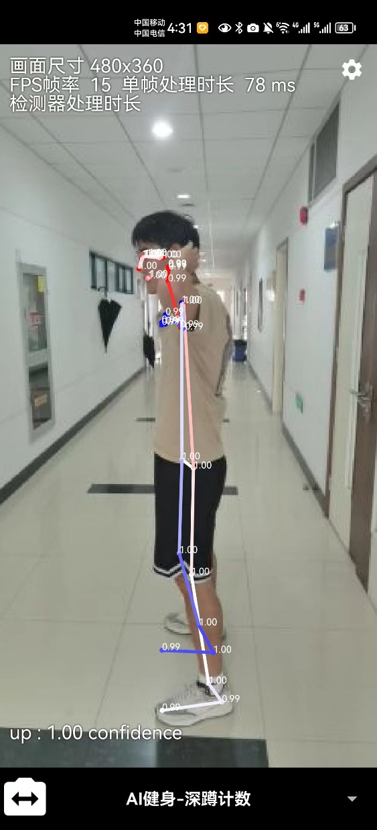
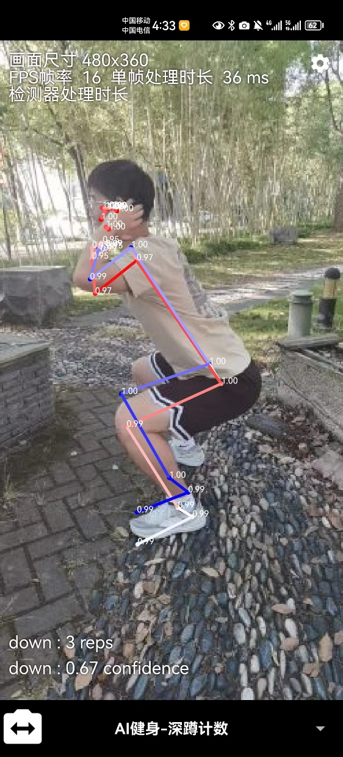
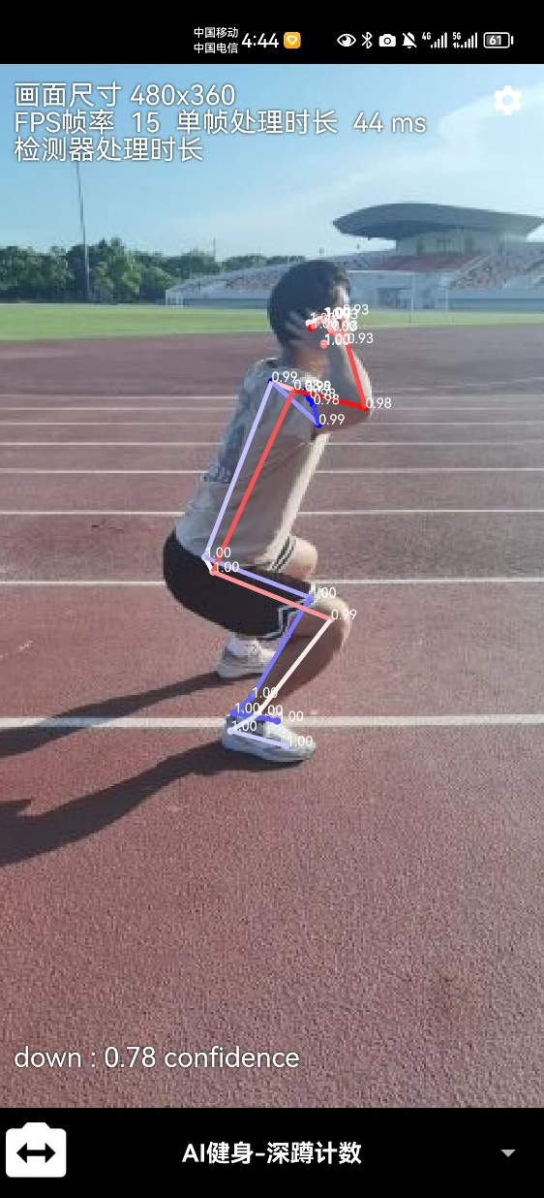
Stage 4 (12-13weeks) | Project functional testing | We need to test our model in different environments,（For example, on the playground, in the dormitory, in the indoor sports field）select at least five scenarios, and count accurately,We need to complete this work within a week.
Places are limited, only three scenarios are listed...

Slide 17
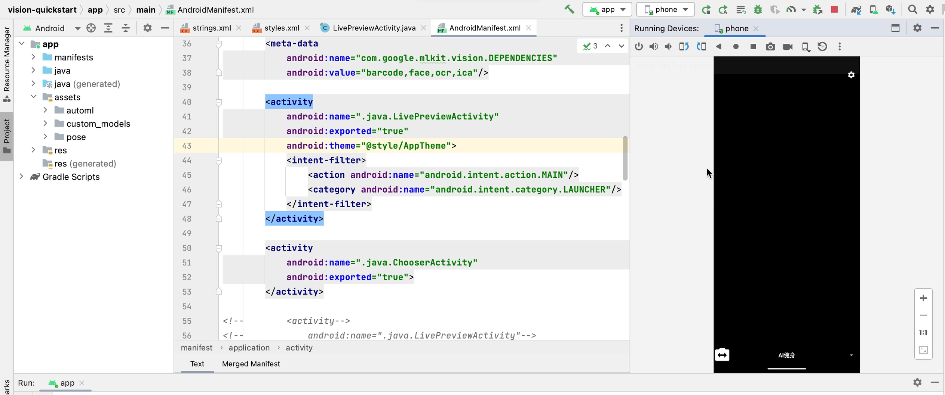
Stage 5 (14-15) | Project deployment | Deploy our project to the front-end app and ensure it can be used normally
Stage5 writes the app code, and imports the algorithm training results into the app, so that the app can count normally, as shown in the following figure:

Slide 18
05
Project Risk
Notes:
I will introduce some important points in our entire project, as well as our current and future work

Slide 19
classification | risk | risk description | grade | probability | impact
Technical risk | The algorithm is inaccurate | The accuracy of the algorithm depends on the quality and quantity of the dataset, and it may be affected if the training dataset is either insufficient or less accurate. | Medium | 10%-30% | 0.6
 | code error | If the code has an error, it may cause the program to crash or produce an incorrect output. | High | 20%-40% | 0.8
 | Compatibility problem | The program may be incompatible with some hardware or software. | Medium | 15%-30% | 0.6
 | security hole | If the program involves user data or sensitive information, security vulnerabilities may exist. | High | 10%-20% | 0.9
 | Performance problems | Performance problems may arise when a program needs to process large amounts of data or perform complex calculations. | Medium | 10%-20% | 0.7
 | Program scalability issues | If the program requires to extend or modify, scalability issues may arise. | High | 10%-20% | 0.6
 | Data quality issues | If the program needs to process large amounts of data, data quality issues may arise. | Medium | 20%-30% | 0.7

Slide 20
classification | risk | risk description | grade | probability | impact
Security risk | Data leakage | If the program involves user data or sensitive information, there may be a risk of data leakage. | High | 5%-20% | 0.8
 | Network attack | If the program communicates through the network, there may be a risk of a network attack. | High | 5%-30% | 0.9
 | malicious software | If the program has a vulnerability or a security vulnerability, it may be attacked by malicious software. | Medium | 5%-20% | 0.6
 | …….

Slide 21
classification | risk | risk description | grade | probability | impact
Manage risk | Demand change risk | In the development process, there may be unclear definition of requirements, insufficient accuracy, or users do not really understand their needs, as well as various problems and technical support in the APP development process, which may cause the risk of demand change. | Medium | It ends on many factors | 0.6
Personnel risk | Poor risk of communication | Poor communication among members of the project is a very important factor affecting the smooth progress of the project. There may be differences in needs, development direction and technology leading to poor communication. | High | It depends on multiple factors | 0.8
Progress risk | Schedule delay | The project is demanding on the schedule, and the project schedule delay means the failed development. | High | 5%-10% | 0.8
…….

Slide 22
06
Project Text
Notes:
I will introduce some important points in our entire project, as well as our current and future work

Slide 23
In order to verify the stability of the program, we conducted various tests on the program, including image key point test, video processing test, camera real-time test, etc.
test environment:
content | Specific instructions
CPU | 1.6 GHz dual-core Intel Core i5
OS | macOS
testing software | Jupyter Notebook
test environment | python3.9
test dependencies | mediapipe opencv-python numpy
client | Safari browser

Slide 24
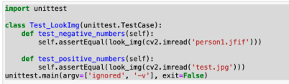
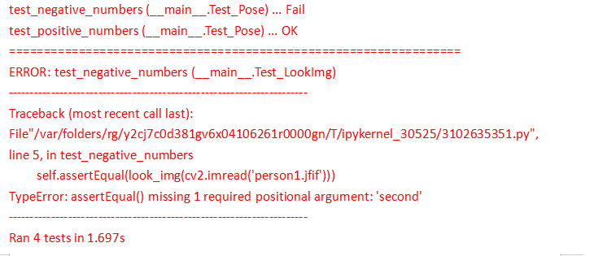
Image key point test_1
Test conditions: The environment required for installation and testing: opencv-python, mediapipe, tqdm, time, matplotlib
Test process: import the toolkit, import the model, read in the image, input the model, obtain the prediction result, and obtain the pixel coordinates of key points.
Expected result: 33 key points of the input image can be obtained, and the coordinates of the key points can be output.
Test result: failed
Reason for failure:OpenCV reads the image in BGR format and Matplotlib visualizes it in RGB format, so it is necessary to convert BGR to RGB
Here is the test code
Running results

Slide 25
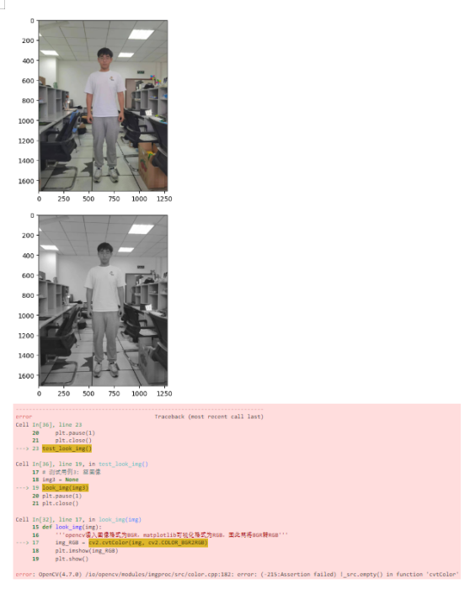
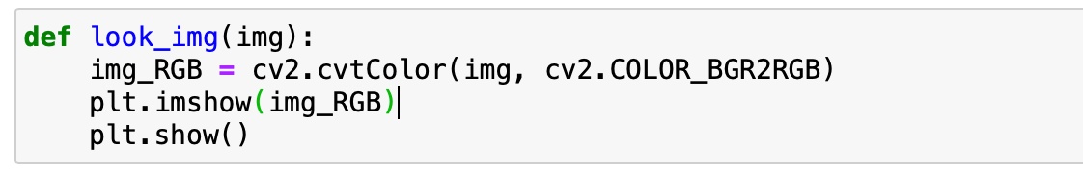
In order to more intuitively verify our test case, our normal RGB images, gray images, and NULL values are passed into the test code, and the results are shown in the following figure
Figure 1 shows a color image, which is look_ One of the most common uses of the img function.
Figure 2 shows a grayscale image to verify whether the function can handle different types of images correctly.
Figure 3 shows an empty image, passing None as the input parameter to look_ IMG function to verify the function's handling of invalid inputs.
This is our modified code to avoid the issue of non-standard image data

Slide 26
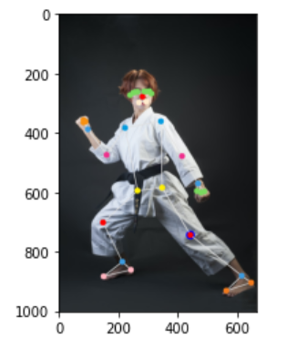
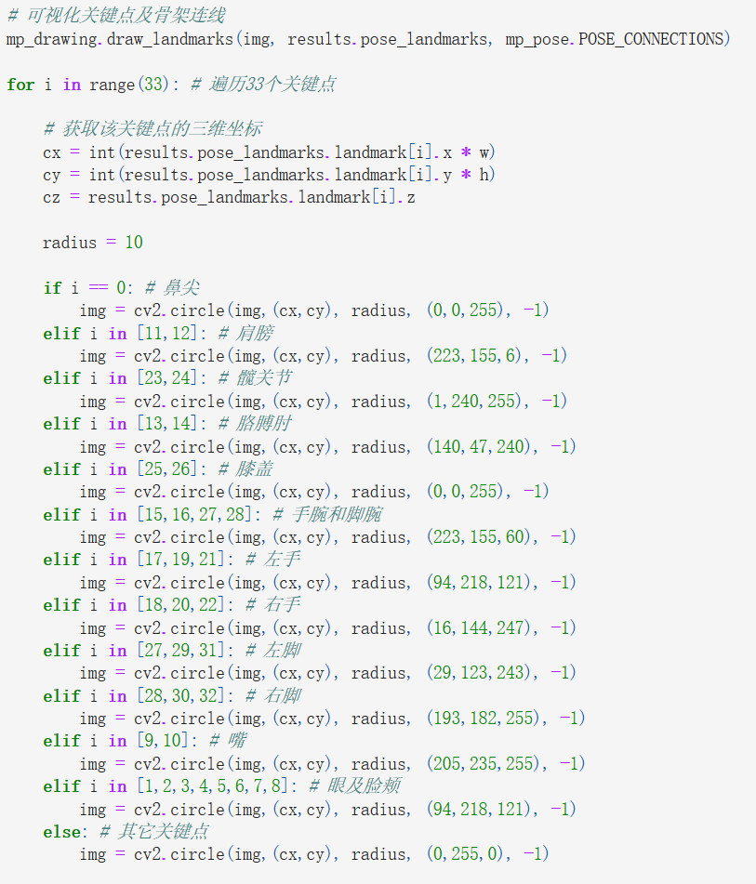
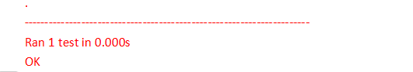
2. Image key point test_2
According to the failure experience of the first test, modify the test parameters, and the test is successful.
The main test code is as follows:
Test Results:

Slide 27
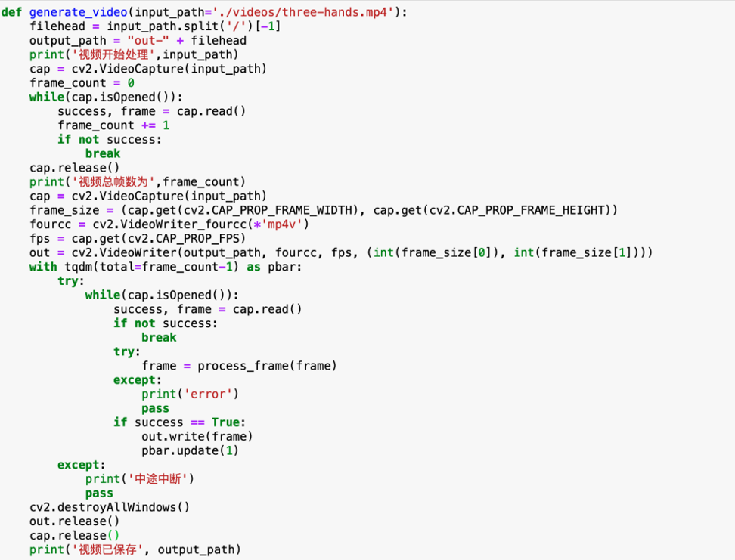
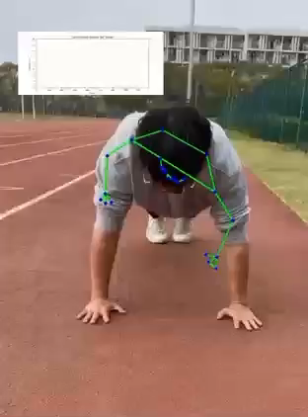
3. Video Processing Test
Test purpose: To test whether the system can normally obtain the joint point information of the input video.
The environment required for installation and testing: opencv-python, mediapipe, tqdm, time
Test process: import toolkit, import model, input model, process single frame data, input video, process video frame by frame Expected result: able to output video containing key point annotations
Test result: passed, as shown in the video below
test code:
Test result：

Slide 28
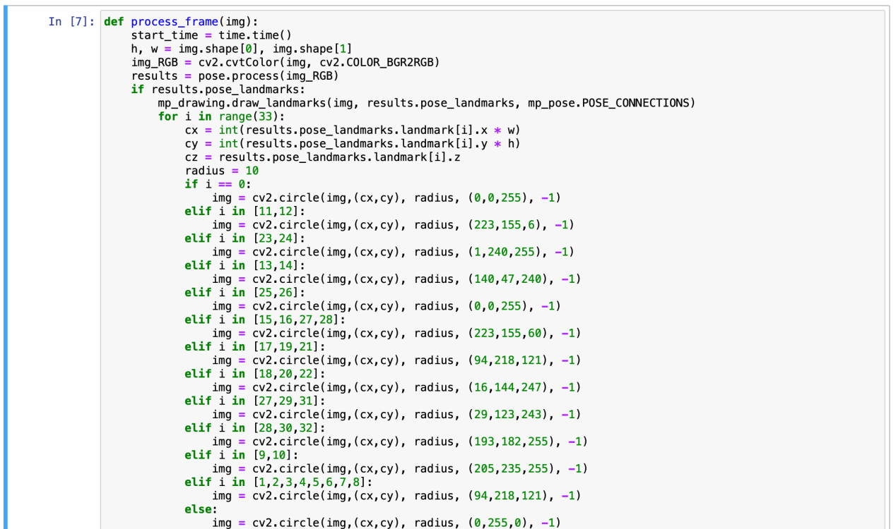
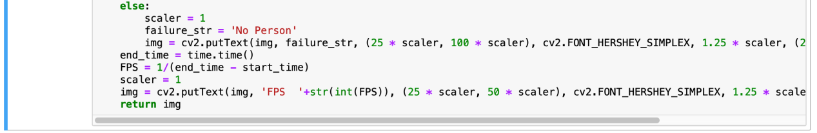
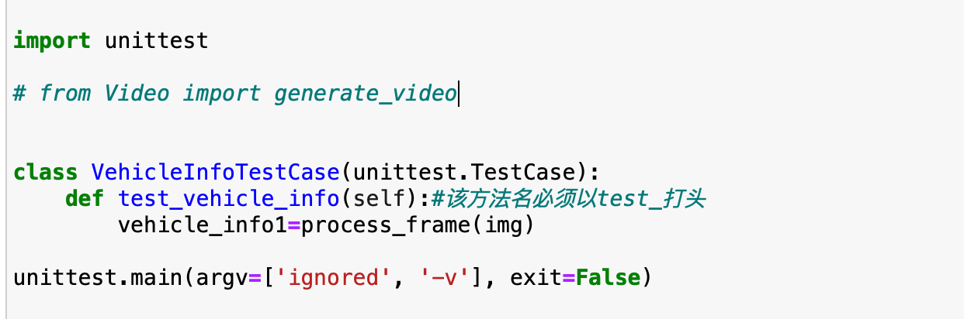
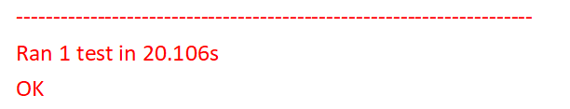
3. Camera real-time test
Test purpose: to test whether the system can normally obtain the device camera input and detect key points.
Test environment: opencv-python, mediapipe, tqdm, time
Test process: import toolkit, import model, input model, process single frame data, call camera to obtain each frame data
Expected result: successfully invoke the device camera, be able to output images in real time, and display key point information
Test result: passed, as shown in the video below
Test code:
Test result：

Slide 29
07
Demo
Notes:
I will introduce some important points in our entire project, as well as our current and future work

Slide 30


The following is the program running demo:
Squat:
push up：

Slide 31
08
Lessons Learned
Notes:
I will introduce some important points in our entire project, as well as our current and future work

Slide 32
During this project, we learned many valuable lessons. Here are some of the lessons we think are the most important:
Always keep it purposeful and user-oriented
Before the project starts, we should have a clear understanding of the requirements and expectations, and ensure that the design and implementation of the software are both requirements-centric. At the same time, we should always keep the project goals clear and consistent, and avoid deviating from the original goals during the development process.
Early testing and feedback gathering
In the project development process, we should conduct testing and feedback collection as early as possible to find and solve problems in time.
Focus on code quality and maintainability
In the process of project development, we should pay attention to code quality and maintainability to ensure the reliability and stability of the software.
Focus on teamwork and communication
Teamwork and communication are very important during project development. We should establish a good communication mechanism to exchange and coordinate various problems and needs in a timely manner. At the same time, we should also pay attention to teamwork and knowledge sharing to improve the overall level and efficiency of the team.

Slide 33
Thanks!

